Slide 1
C++ Programming Today 2nd Edition By Barbara Johnston Chapter 2
Instructor: <Instructor Name>
Lecture Slides by Kelly Montoya and Rob Garner

Slide 2
Chapter 2
Programming Fundamentals
Steps to Programming Success
Computer Programming Terminology
Format of a C++ program
Commenting Code
Preprocessor Directives
Main Function
C++ Statements
Sample Code
Whitespace
Language Syntax and Compiler Errors
Keywords
Commenting
Data Types
Variable Declaration
Initializing Variables
Operators
Stored Values
Arithmetic Operators
Precedence of operations
Accumulation
Getting Data to/from User
#define Preprocessor Directive
Const Modifier
Data Casts
Formatting Output
String Class

Slide 3
Programming Fundamentals
Explain fundamental programming concepts.

Slide 4
Programming Fundamentals
Understand the problem or the goal and then come up with a plan of how to achieve it.
Algorithm Design
An algorithm is a process or set of rules or steps to follow for solving a problem.
Create a set of steps that solves the problem before you start entering source code.

Slide 5
Example – Counting Sheep

Slide 6
Example – Surface Area
Fig 2-2

Slide 7
Steps to Programming Success
List and describe steps to programming success.

Slide 8
Step 1. Read the problem statement
Understand the problem and what it is that you are being asked to do.
Know what the program inputs are and how they come into the program, as well as the program’s outputs.
Understand what the problem is and the desired results.

Slide 9
Step 2. Identify Software Requirements
List the main program components you need to solve your problem.
Identify individual software components as we did in the ATM and car servicing examples in Chapter 1.
Identify the main pieces and an order in which they’ll be built.
It is not necessary to lay out every detail at this stage, but know the major components of your program.

Slide 10
Step 3. Build a subset of the software requirements
Create a base version of your software so that you can see the key aspects of the program and how it is working.
Use pencil and paper to lay out the details and prepare test cases.
Write out a plan in diagrams, develop flow diagrams or descriptions in pseudocode.
Identify items that can be individually tested.

Slide 11
Step 4. Evaluate the base version
Does this version meet the desired requirements? Is a redesign necessary?
Test the base program. Go back and fix problems with the base version.
If the base version is good, make a list of the software tasks for the next version of the program.
Develop testing methods for the next iteration of software.

Slide 12
Step 5. Iteration Step
Implement the new tasks for the next version (or stage) of your software.
Be simple, straightforward, and support any redesign or new task.
Document your source code explaining the important details.

Slide 13
Step 6. Evaluation Step
Ensure that the software is working per the requirements list.
Obtain feedback from a user, results from test cases, and determine how it meets the end goals.
Test this new software, as well as the functionality from the previous iteration. (You do not want to have your new code break something in your previous code!)
Make a list of the features for the next iteration of the software.
Note: Steps 5 and 6 may have to be repeated!

Slide 14
Computer Programming Terminology
Define key computer programming terms.

Slide 15
Terminology and Project Construction

Slide 17
Format of a C++ program
Describe the general format of a C++ program

Slide 18
General Format of a C++ Program
C++ is case sensitive.
“total”, “Total”, and “TOTAL” are separate things.
C++ programs are written inside functions.
A function has a specific format, an entrance point, and one (or many) exit points.
All functions have a name, a means to pass data into it and obtain data from it.
Functions do program tasks.
The starting point for our C++ programs is the main() function.

Slide 19
Making a C++ Project
Demonstrate how to make a C++ Project

Slide 20
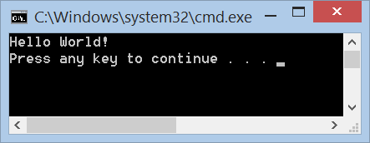
Hello World! Program
//Getting Started with Hello World.
//This is our first program.
#include <iostream>
using namespace std;
int main()
{
cout << "Hello World! \n";
return 0;
}

Slide 21
"total", "Total" and "TOTAL" are all identical things in C++
True
False

Slide 22
Code examples below will:
Execute the same
Not execute the same because they are on different lines and the spacing is different.
myVariable
=
15;
myVariable=15;
And

Slide 23
Commenting Code
Explain how to comment code.

Slide 24
Comments
Comment lines are written into the source file to relay information concerning the code such as titles, file data, or explanations about what the software is doing.
The compiler ignores all comment lines in a program. There are two ways to write comments in C++.

Slide 25
// comments are convenient for one-liners.
//This is one way to write a comment.
//The compiler ignores everything from //the two forward slashes to the end of //the line.
Multiple-line comments
/* Another way to write a comment. The compiler ignores everything between the beginning slash-star and the ending star-slash. */

Slide 26
Preprocessor Directives
Explain preprocessor directives.

Slide 27
Preprocessor Directives
#include <iostream>
Preprocessor directives give the compiler instructions.
iostream is a library containing tools that are needed to write output statements to the screen or read data from the keyboard.
The #include statement tells the compiler that the program uses the iostream tools.

Slide 28
Preprocessor Directives
C++ provides many libraries with many tools for programmers to use.
If you wish to use one of the standard C or C++ functions, you have to include the name of the appropriate library.
#include <cmath> //used for math functions //i.e.,sqrt(), cos(), etc.
#include <iostream> //writes output to screen //reads from keyboard
#include <iomanip> //for output formatting

Slide 29
The using namespace std; Statement
This tells the compiler that your program is using the standard C++ namespace which includes the C++ libraries.
Namespaces are used to organize the program and avoid problems with program components having the same name.
We need to have the using namespace std; statement after our #include statements.

Slide 30
Main Function
Explain the role of the main function in a C++ program.

Slide 31
The main Function
int main()
{
...
This is the starting point for a C++ program.
C++ programs contain a main() function, and the operating system knows to look for it.
The main() function is the “program director” that “calls” other program components via functions (or through the use of objects).

Slide 32
Function Header Line
The function header line is the first line of any function. It specifies the function’s name and its input and output information.
The general format for a function header line is:
return_type is the type of data that the function passes to whomever calls it.
The input parameter list is the list of data that is passed into the function.
return_type function_name(input parameter list)

Slide 33
Opening and closing braces { }
All C++ functions have an opening brace { after the function header line; at the end of the function is a closing brace }.
These braces enclose the statements of the function.
Braces are used extensively in C++.

Slide 34
C++ Statements
Explain C++ Statements

Slide 35
C++ Statements
C++ statements issue commands to be executed
Many, but not all, statements in C++ end in a semicolon

Slide 36
C++ Statements
The Hello World! program has two C++ statements
cout (“cee-out”) is an object that directs output.
The “<<” operator sends data to the console window.
The return 0; passes a zero out of main back to the operating system.
cout << "Hello World! \n";
return 0;

Slide 37
Sample Code
Illustrate structure of a program with some code.

Slide 38
How’s the Weather?
/*This program writes a few weather-related
statements to the screen. */
#include <iostream>
using namespace std;
int main()
{
//Weather Information
cout << "\n It is cloudy today.";
cout << "\n Maybe it will rain.";
cout << "\n I like sunny, warm weather! \n";
return 0;
}
Use /* to open and */ to end a multi-line comment
Use // for a single line comment

Slide 39
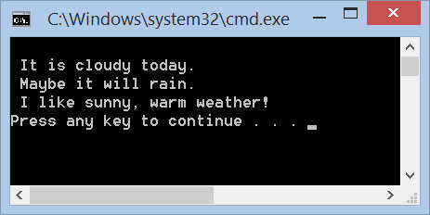
Program Output
Note that the comments are seen only in the source code.
The \n is an escape sequence, which causes the output to be printed to the next line on the screen.

Slide 40
Whitespace
Explain how C++ processes whitespace characters.

Slide 41
Whitespace Characters and Flexible Style in C++
Whitespace characters are defined to be spaces, carriage returns, line feeds (the Enter key), tabs, vertical tabs, and form feeds.
The compiler ignores whitespace characters.
The compiler allows the code to be written with the use of a wide variety of styles and formats.

Slide 42
C++ statements can be written in virtually any format.
For example, our Hello World! program could be written on one line.
//Our Hello World program written in one line.
#include <iostream>
using namespace std;
int main(){ cout << "Hello World! \n"; return 0;}
Note how difficult it is to read this version. Good style is very important.

Slide 43
Language Syntax and Compiler Errors
Explain language syntax and how the compiler process/reports errors.

Slide 44
Language Syntax and Compiler Errors
C++ must be written with correct syntax.
A syntax rule is a rule for writing the language.
Spoken languages have grammar rules.

Slide 45
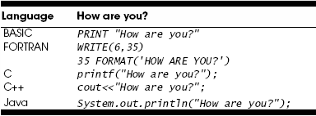
Computer programming languages also have grammar rules.

Slide 46
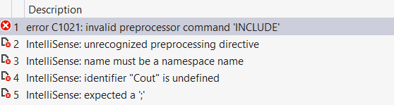
Syntax Errors
Compilation stops at the preprocessor line and issues an error showing the line number.
//Our Hello World! program with syntax errors
//This code will not compile.
#INCLUDE <iostream> //#include cannot be //all capital letters
using namespace standard;//C++ knows "std", not //standard
int Main ()// main must be lowercase
{
Cout << "Hello World!";//cout must be lowercase
return 0 //missing ;
}

Slide 47
Keywords
Objective: Explain what a keyword is.

Slide 48
C++ Keywords
The C++ language has many reserved words known as keywords.
The C language contained 31 keywords. The C++ language expanded that list to 63.
These keywords have specific meaning and may not be used as names for variables or functions.
Each keyword has specific syntax and actions associated with it.

Slide 50
Commenting
Objective: Demonstrate proper formatting and use of comments.

Slide 51
Good Style
It is necessary to develop a readable style when writing source code.
This legible style includes:
writing descriptive comments
choosing appropriate variable names
indenting the source code from the start of the project
Always assume that others will read your code and have to figure out what you were doing.
Show prog 2-5

Slide 52
One Last Comment on Comments
Your comments should explain your thought process and logic. This is good comment!
This is a bad comment!
Not only is it hard to tell where the statement ends and the comment begins, it also doesn’t explain why iostream is needed.
Ensure that your comments help the reader understand what you are writing.
#include <iostream> //needed for screen/keyboard I/O
#include <iostream> //include iostream lib

Slide 53
Chapter 2
Programming Fundamentals
Steps to Programming Success
Computer Programming Terminology
Format of a C++ program
Commenting Code
Preprocessor Directives
Main Function
C++ Statements
Sample Code
Whitespace
Language Syntax and Compiler Errors
Keywords
Commenting
Data Types
Variable Declaration
Initializing Variables
Operators
Stored Values
Arithmetic Operators
Precedence of operations
Accumulation
Getting Data to/from User
#define Preprocessor Directive
Const Modifier
Data Casts
Formatting Output
String Class

